Slide 1
Chess Games Winter Term 2015 Sprint 1 Presentation
Presented By:
Aaron Costner Lewis Sanchez
Jacob Neal Stewart Taylor

Slide 2
Overview of presentation
Goals/Accomplishments of Sprint
Traceability Matrix
Use Cases
Sequence Diagrams
Class Diagrams
Demonstration of Code
Plans for Next Sprint
Q&A

Slide 3
Goals/Accomplishments of Sprint
Aaron Costner

Slide 4
Goals/Accomplishments of Sprint
Conversion of code to use QML rather than Qwidgets.
Creation of network server and client code for connecting chess players to a match.
Creation of CG_Lobby, a page of our application that will essentially act as the main hub.

Slide 5
Traceability Matrix
 | UC001 | UC002 | UC003 | UC004 | UC005 | UC006 | UC007 | UC008 | UC009 | UC010 | UC011
1ai | X
1aii | X
1aiii | X
1b | X
1ci | X
2ai
2aii
3a
3b
4a
4b
4c
4d
5ai |  | X
5aii
6ai
6bi
7a
8
9
10
11
12 |  |  | X | X
12a

Slide 6
Use cases
Stewart Taylor

Slide 7
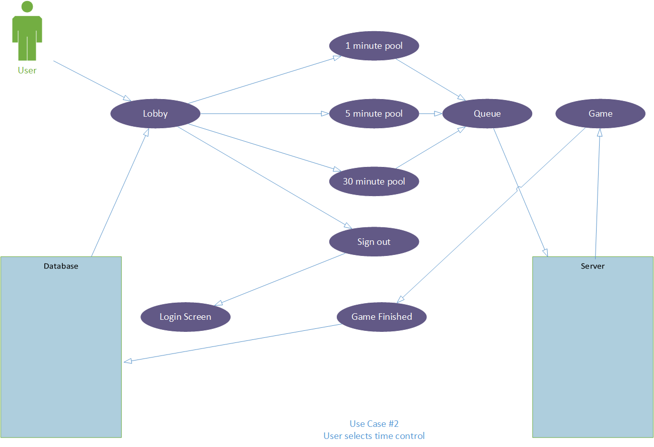
Use Cases

Slide 8
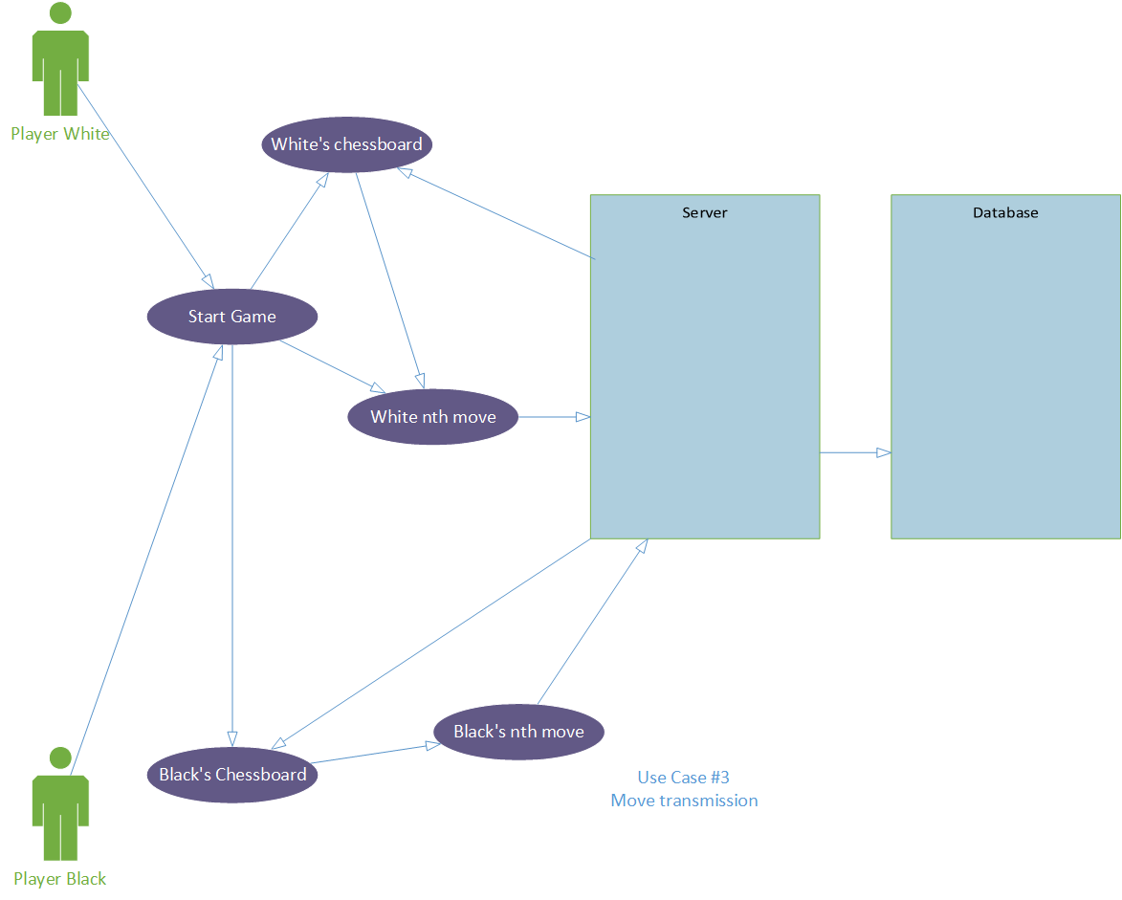

Slide 9
Sequence diagrams
Jacob Neal

Slide 10
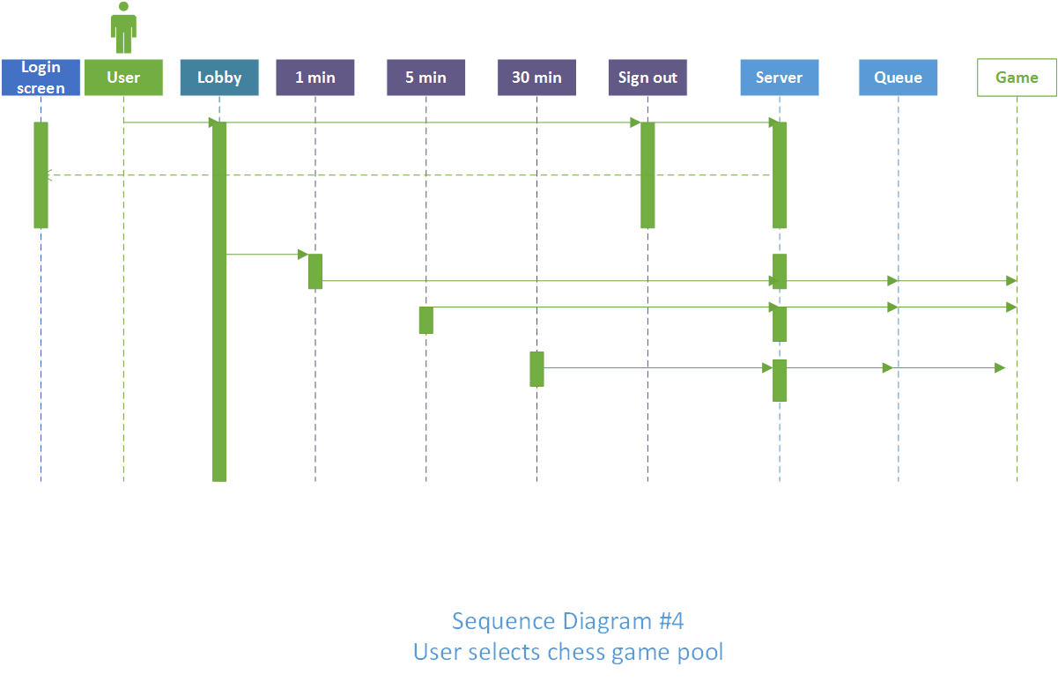
Sequence diagrams

Slide 11
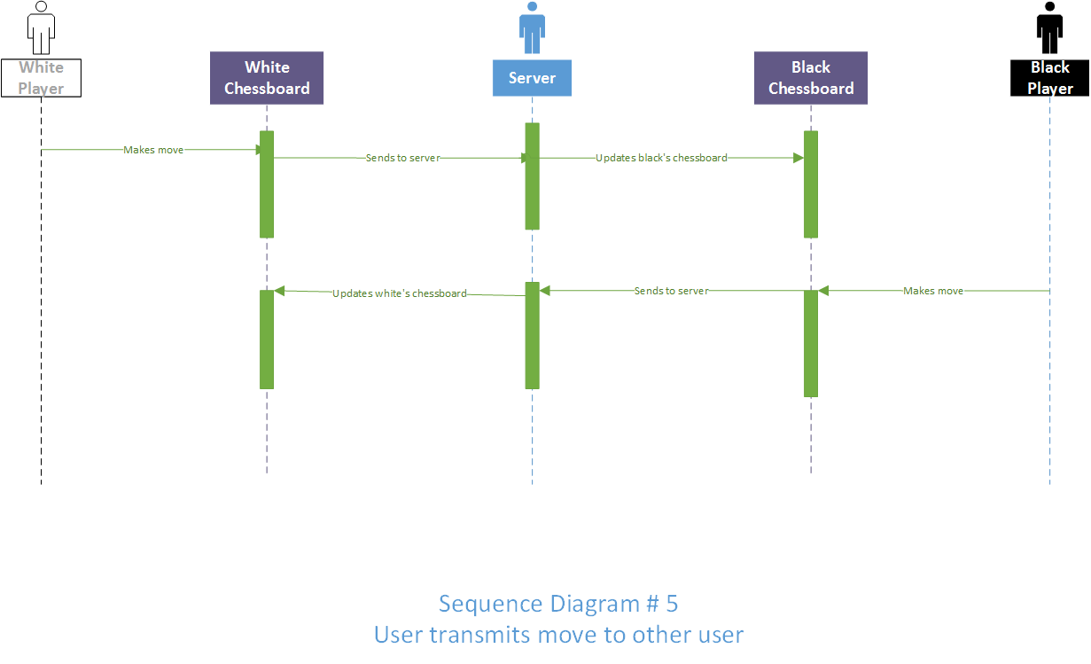

Slide 12
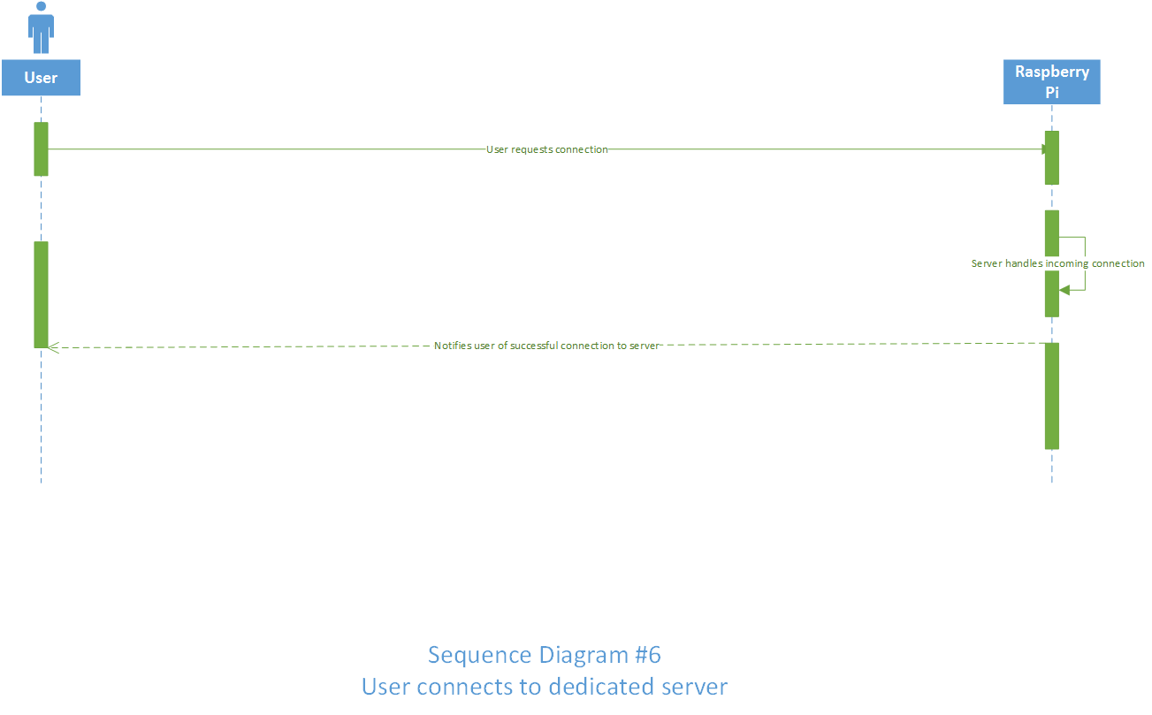

Slide 13
Class diagrams
Lewis Sanchez

Slide 14
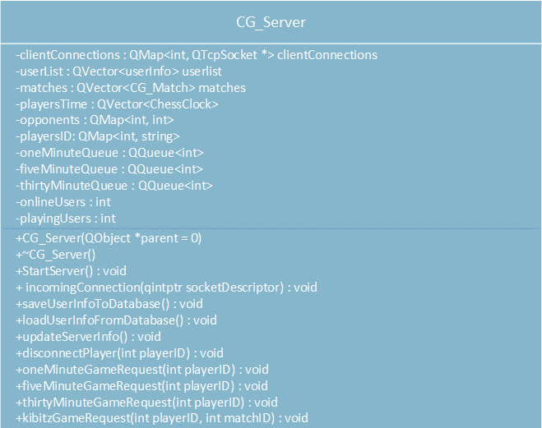
Class diagrams

Slide 15
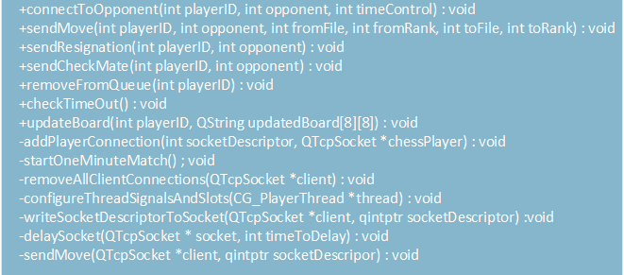

Slide 16
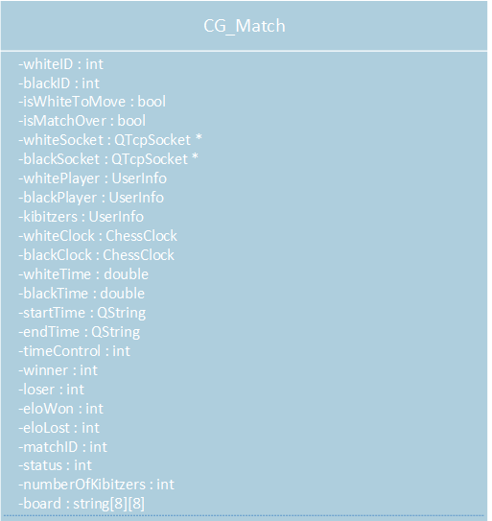

Slide 17
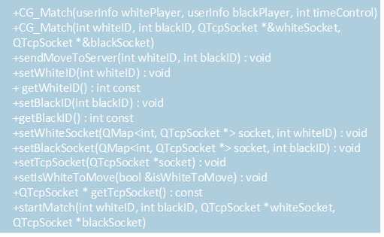

Slide 18
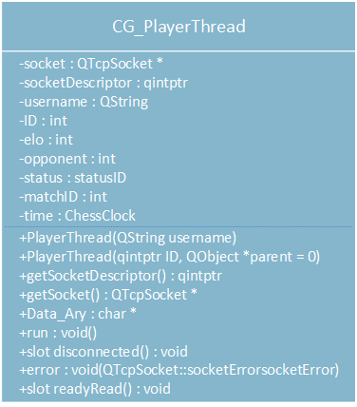

Slide 19
Before the demonstration
We have essentially two things we would like to demonstrate:
The CG_Lobby code integrated with our CG_Login code from before, with QML code shown
The network we have set up using servers, clients, and TCP Sockets in QT
We are going to show some code snippets before the demo
We would love to hear your suggestions on how to implement the networking component of our project!

Slide 20
Code Snippets
Lewis Sanchez, Jacob Neal, Stewart Taylor, & Aaron Costner

Slide 21
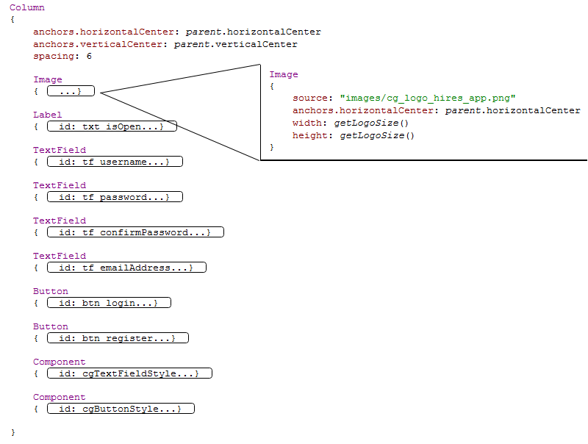
CG_LogIn QML

Slide 22
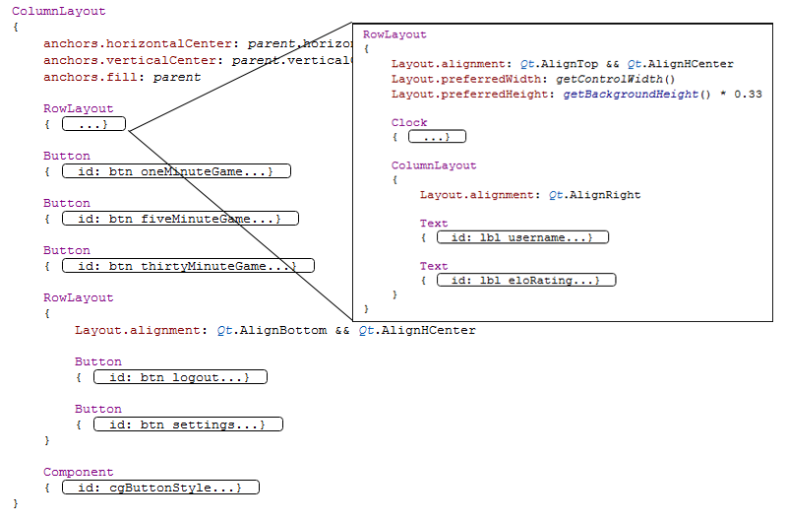
CG_Lobby QML Code

Slide 23
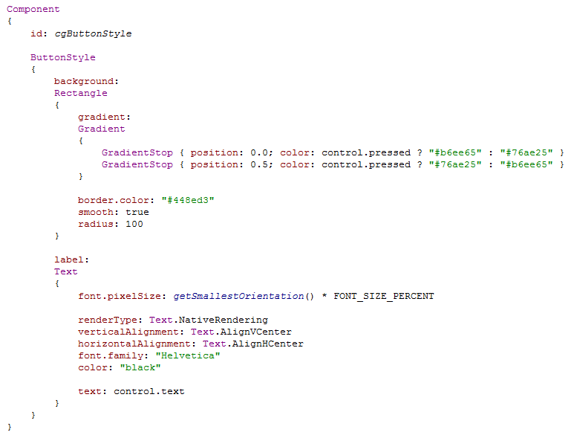
Button Style

Slide 24
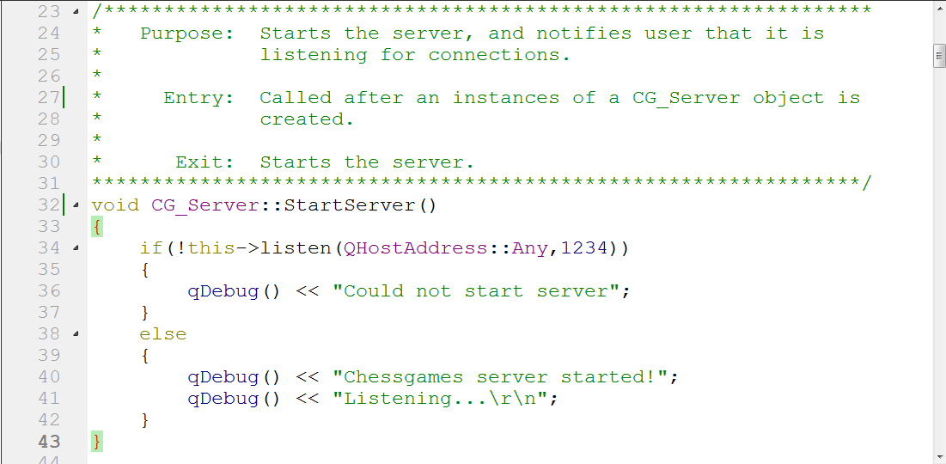
Notes:
CG_Server StartServer function.

Slide 25
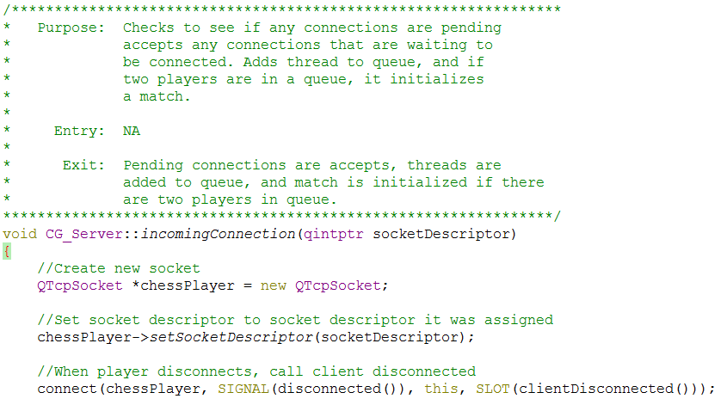
Notes:
First part of CG_Server’s incomingConnection function.

Slide 26
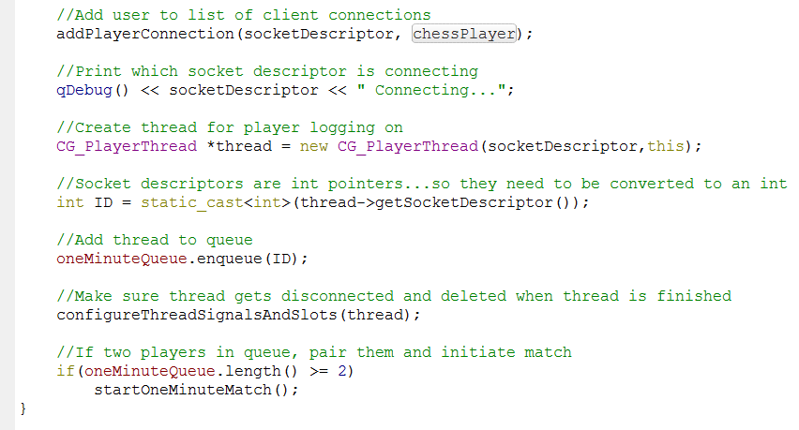
Notes:
Second Part of CG_Server’s incomingConnection function.

Slide 27
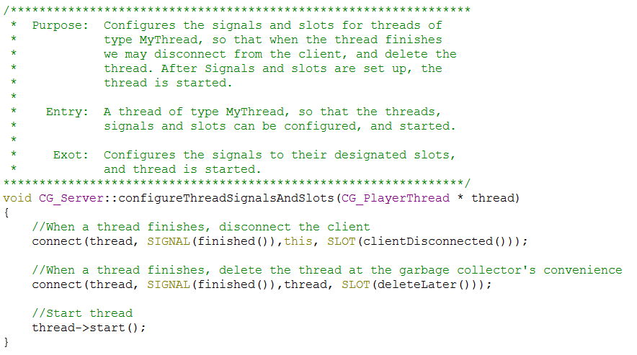
Notes:
CG_Server configureThreadSignalsAndSlots function.

Slide 28
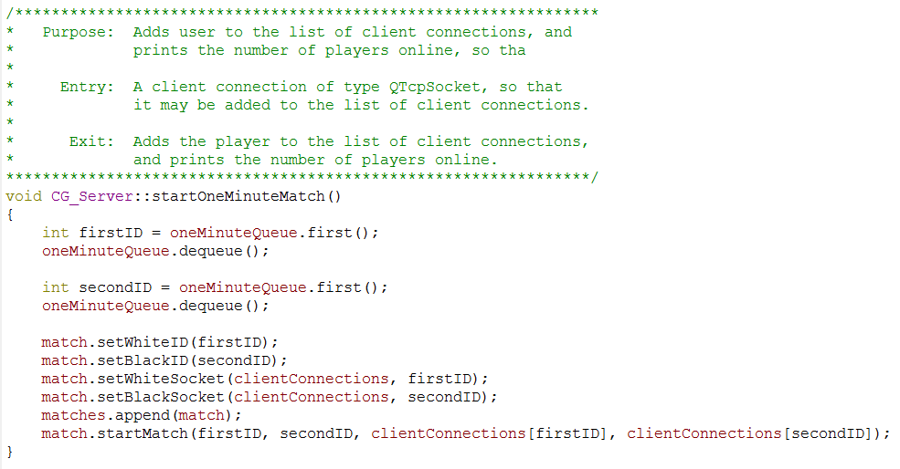
Notes:
CG_Server startOneMinuteMatch function.

Slide 29
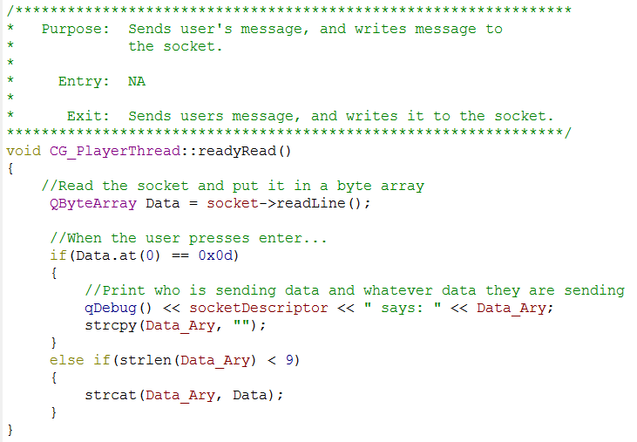
Notes:
CG_PlayerThread readyRead function.

Slide 30
Demonstration of Code
Lewis Sanchez, Jacob Neal, Stewart Taylor, & Aaron Costner

Slide 31
DEMO

Slide 32
DEMO

Slide 33
Plans for next sprint
Aaron Costner

Slide 34
Plans for next sprint
Remove use of Telnet for client connection and writing a client that interfaces with the server.
Loading screen developed and implemented for when a player enters a queue to find an opponent.
Connecting the CG_Login, CG_Lobby, and CG_Server classes together.
Develop CG_Chessboard and CG_ChessPieces for a CG_Match, but not the move validations.
Get our SQLite database to connect with our application on mobile devices.

Slide 35
Q&A
Lewis Sanchez, Jacob Neal, Stewart Taylor, & Aaron Costner

Slide 36
Thank you for your time!
Special thanks go out to Chris Dean for his help in helping us with networking and database issues in QT!

